Slide 1

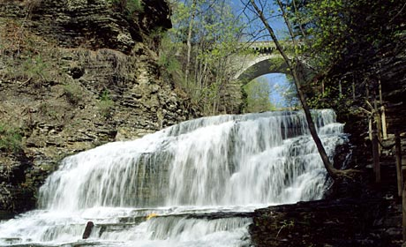
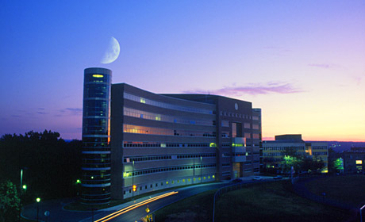


Final Presentation: Waste Plastic Plant Design Presentation
The ASPEN Plus – Dawson Grimm, James Hayes, Joshua Rodrigues, Joseph Yoon
Monday, May 8th, 2023
Robert Frederick Smith School of
Chemical and Biomolecular Engineering
Cornell University
Ithaca, NY 14853

Slide 2

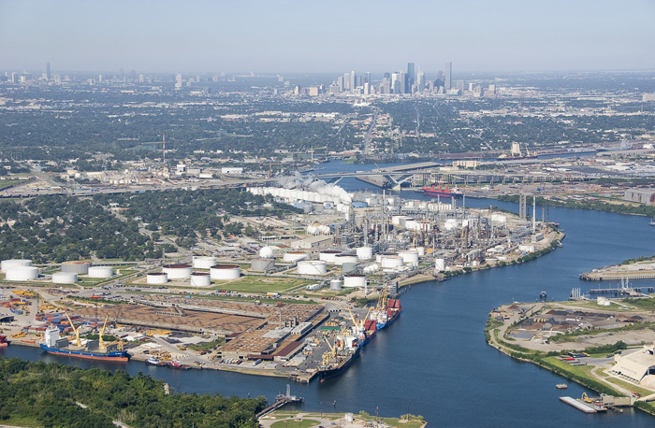
Overview & Agenda
Our Team: The ASPEN Plus
Our Project: Design of a waste plastics recycling plant
Today’s Goal: Provide summary of project
Background
Assumptions
PFD
Equipment Design
Engineering Considerations
Plant Layout, ISBL, OSBL
Process Control
Market Analysis
Economic Analysis
The ASPEN Plus
The ASPEN Plus
Waste Plastic Recycling Plant Design
May 8th, 2023

Slide 3
Background
Introduction
Pyrolysis presents an opportunity to recover products from waste plastics
Possible products include wax, olefins, liquid hydrocarbons (e.g. benzene), and fuel gas
We have designed a pyrolysis process with a feed rate of 300,000 tons/yr HDPE
Wax is the primary product due to its high profit margin ($0.97/lbm price) and simple separation from other products
Planned Location is Baytown, TX, on the east bank of the Houston ship channel
Total CAPEX has been estimated at $81.1M
Total OPEX has been estimated at $36.1M/yr
Question to address: the price that may be paid for waste HDPE to generate a 15% after tax DCFROR
Estimated at $0.59/lbm
Current prices are around $0.35-0.45/lbm
The ASPEN Plus
May 8th, 2023
Notes:
.

Slide 4
Key Assumptions and Limitations
We assume negligible tar/char will be formed in pyrolysis reactor
Any elemental C would react with water in reactor
All solid products are wax
We assume lab-scale data will scale up to capacity of our proposed facility (300,000 tons/yr)
Yields of products will be the same for given design temperature
Wax modeled as N-pentacostane (C₂₅H₅₂)
In reality, there would be a distribution of wax molecular weight (MW)
Effect of colorants in HDPE on product yields not considered
Potential for LDPE to be used as feedstock
Was not considered, but there is no immediate reason why process couldn’t run with it, although yields might be different
The ASPEN Plus
May 8th, 2023

Slide 5
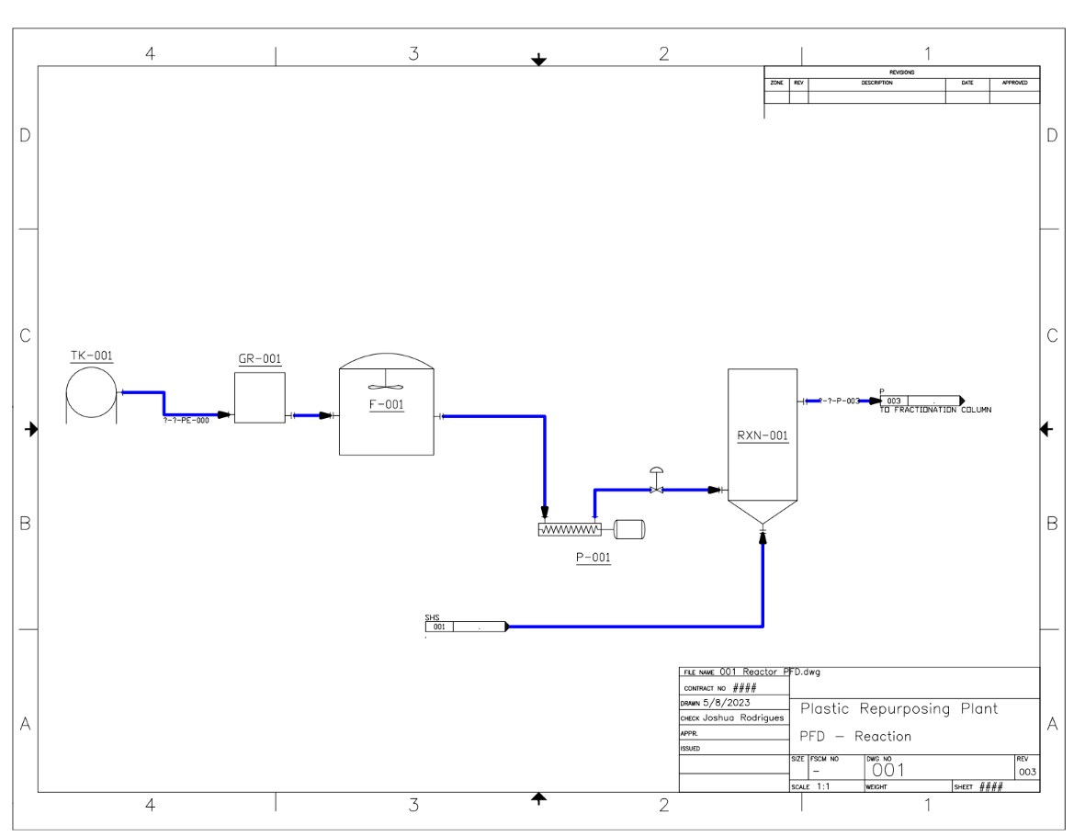
Final PFD
PFD - Reactor
The ASPEN Plus
May 8th, 2023

Slide 6
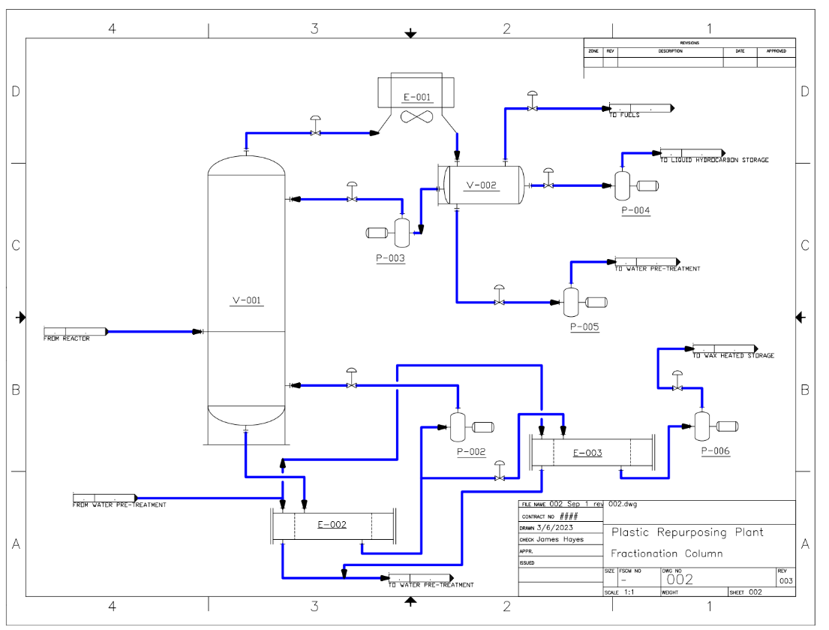
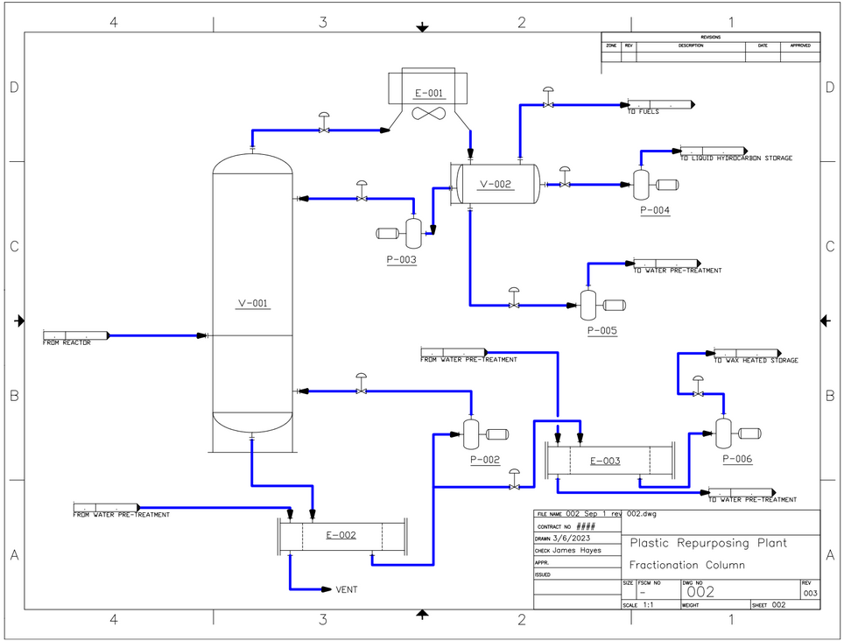
Final PFD
PFD – Column
The ASPEN Plus
May 8th, 2023

Slide 7
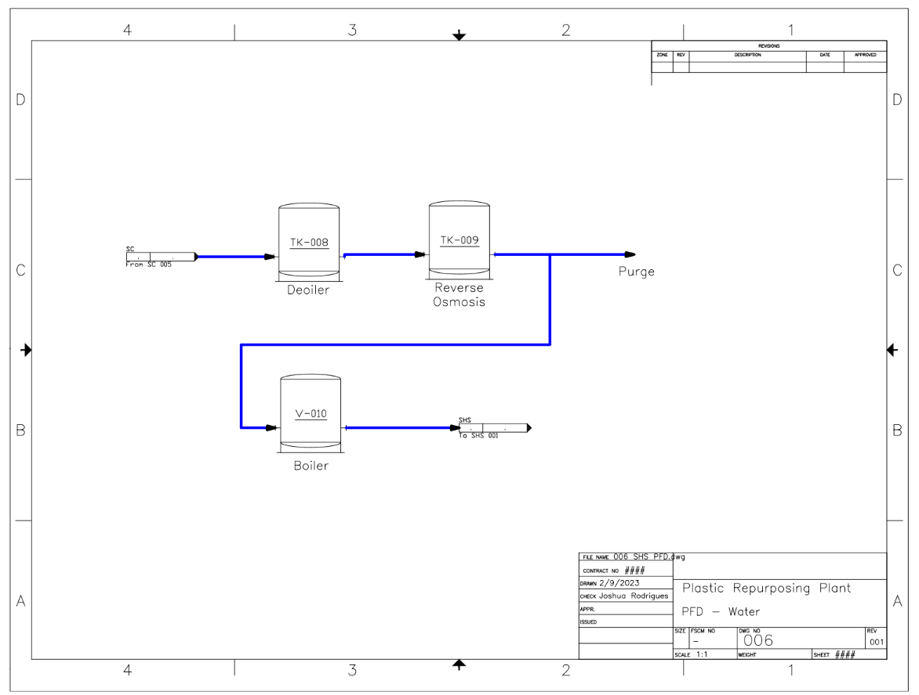
Final PFD
PFD – Water Treatment
The ASPEN Plus
May 8th, 2023

Slide 8
Product Yield
Data from lab scale pyrolysis of HDPE was used
Temperature of 930°F (500°C) was selected due to higher yield of wax
Wax has higher potential profit margin and easier separation
Liquid hydrocarbon mixture and vapor hydrocarbons (fuels) will be produced in smaller amounts
Chemical | Yield (wt%) | Boiling Point (°F) | Production Rate (tons/yr)
Wax and Tar | 97.58 | ~700 | 292,740
Ethylene | 0.64 | -154.7 | 1,920
Propylene | 0.37 | -53.7 | 1,110
Butylene | 0.35 | 20.7 | 1,050
Toluene | 0.30 | 231.1 | 900
Pentane | 0.21 | 97 | 630
Propane | 0.19 | -43.6 | 570
Ethane | 0.13 | -128.2 | 390
Methane | 0.09 | -258.9 | 270
Benzene | 0.09 | 176.2 | 270
Butane | 0.04 | 30.2 | 120
Product | Production Rate (tons/yr)
Wax | 293,000
Liquid Hydrocarbons | 2,110
Vapor Hydrocarbons | 6,330
Conesa, Juan A., et al. “Pyrolysis of Polyethylene in a Fluidized Bed Reactor.” Energy & Fuels, vol. 8, no. 6, 1994, pp. 1238–1246., https://doi.org/10.1021/ef00048a012.
Wax is main product of pyrolysis reaction under these conditions
The ASPEN Plus
May 8th, 2023

Slide 9
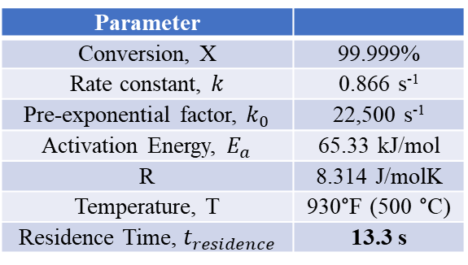
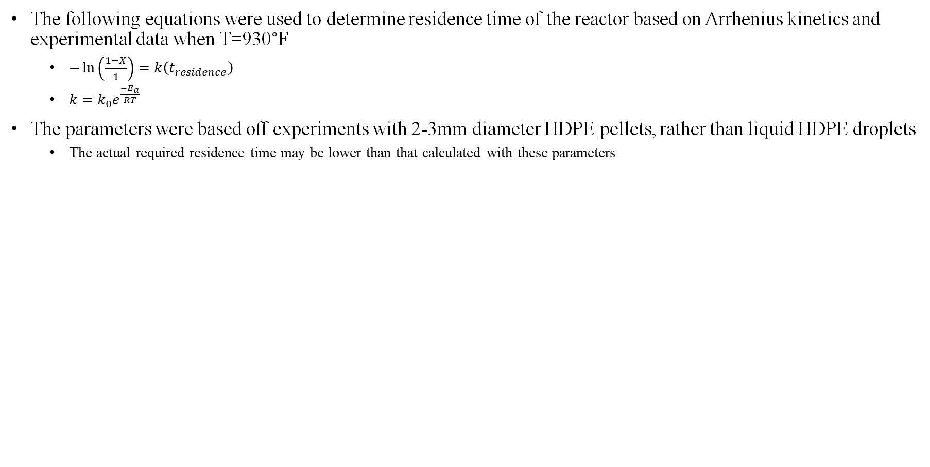
Pyrolysis Reactor
The following equations were used to determine residence time of the reactor based on Arrhenius kinetics and experimental data when T=930°F
$−\ln\left(\frac{1−X}{1}\right)=k\left(t_{residence}\right)$
$k=k_{0}e^{\frac{−E_{a}}{RT}}$
The parameters were based off experiments with 2-3mm diameter HDPE pellets, rather than liquid HDPE droplets
The actual required residence time may be lower than that calculated with these parameters
Parameter
Conversion, X | 99.999%
Rate constant, $k$ | 0.866 s⁻¹
Pre-exponential factor, $k_{0}$ | 22,500 s⁻¹
Activation Energy, $E_{a}$ | 65.33 kJ/mol
R | 8.314 J/molK
Temperature, T | 930°F (500 °C)
Residence Time, $t_{residence}$ | 13.3 s
Khaghanikavkani, E. & Farid, Mohammed. (2011). Thermal pyrolysis of polyethylene: Kinetic study. Energy Sci. Technol. 2. 1-10.
Reactor Residence Time = 13.3 seconds
The ASPEN Plus
May 8th, 2023

Slide 10
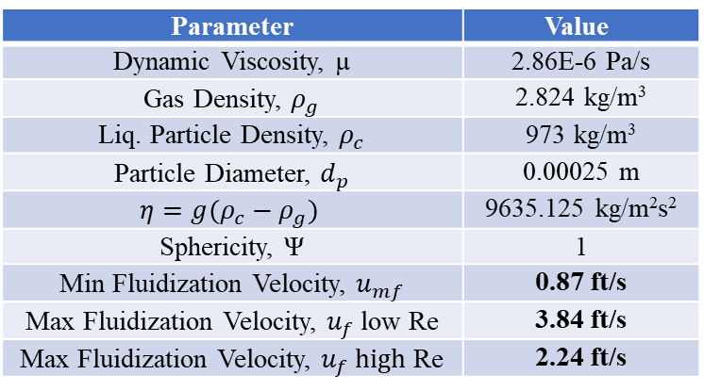
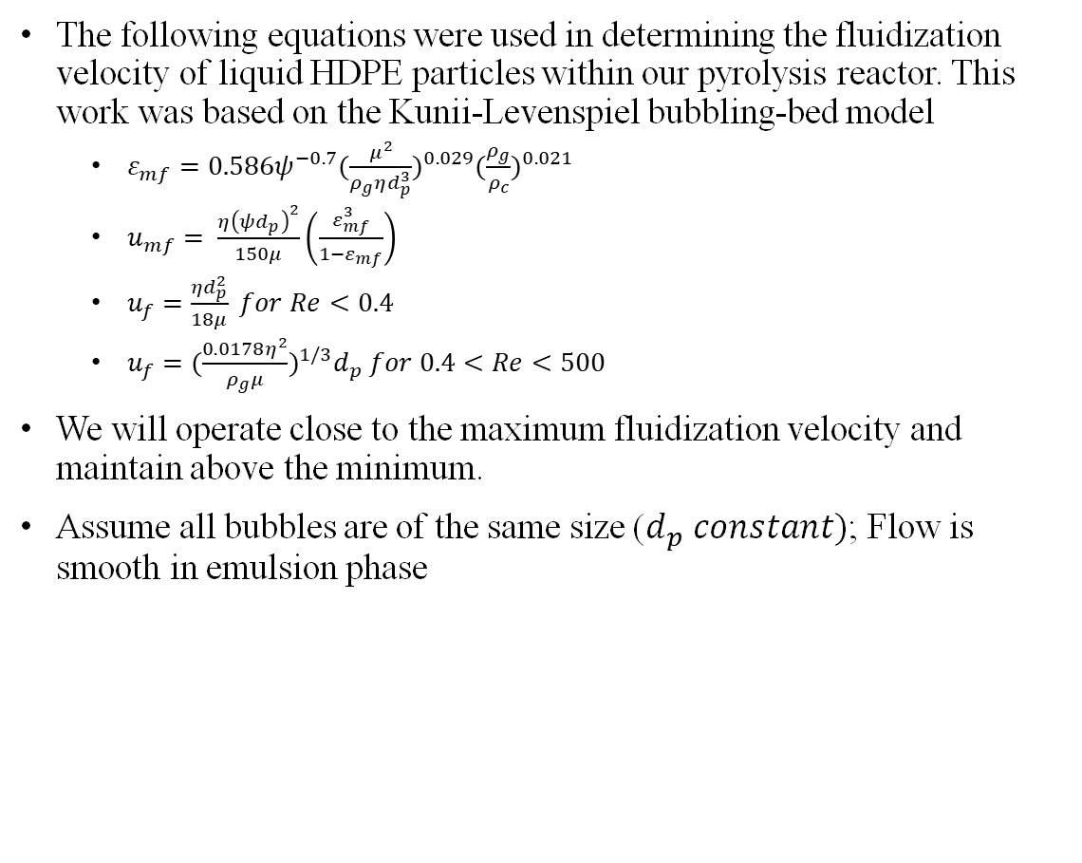
Pyrolysis Reactor
The following equations were used in determining the fluidization velocity of liquid HDPE particles within our pyrolysis reactor. This work was based on the Kunii-Levenspiel bubbling-bed model
$ε_{mf}=0.586ψ^{−0.7}{(\frac{μ^{2}}{ρ_{g}ηd_{p}^{3}})}^{0.029}{(\frac{ρ_{g}}{ρ_{c}})}^{0.021}$
$u_{mf}= \frac{η{\left(ψd_{p}\right)}^{2}}{150μ}\left(\frac{ε_{mf}^{3}}{1−ε_{mf}}\right)$
$u_{f}=\frac{ηd_{p}^{2}}{18μ} for Re<0.4$
$u_{f}={(\frac{0.0178η^{2}}{ρ_{g}μ})}^{1/3}d_{p} for 0.4<Re<500$
We will operate close to the maximum fluidization velocity and maintain above the minimum.
Assume all bubbles are of the same size ($d_{p} constant)$; Flow is smooth in emulsion phase
Parameter | Value
Dynamic Viscosity, µ | 2.86E-6 Pa/s
Gas Density, $ρ_{g}$ | 2.824 kg/m³
Liq. Particle Density, $ρ_{c}$ | 973 kg/m³
Particle Diameter, $d_{p}$ | 0.00025 m
$$η=g(ρ_{c}−ρ_{g})$$ | 9635.125 kg/m²s²
Sphericity, Ψ | 1
Min Fluidization Velocity, $u_{mf}$ | 0.87 ft/s
Max Fluidization Velocity, $u_{f}$ low Re | 3.84 ft/s
Max Fluidization Velocity, $u_{f} high$ Re | 2.24 ft/s
D. Kunii and O. Levenspiel, Fluidization Engineering (Melbourne, Fla.: Robert E. Krieger Publishing Co., 1969)
Max Fluidization Velocity = 2.24 ft/s
The ASPEN Plus
May 8th, 2023

Slide 11
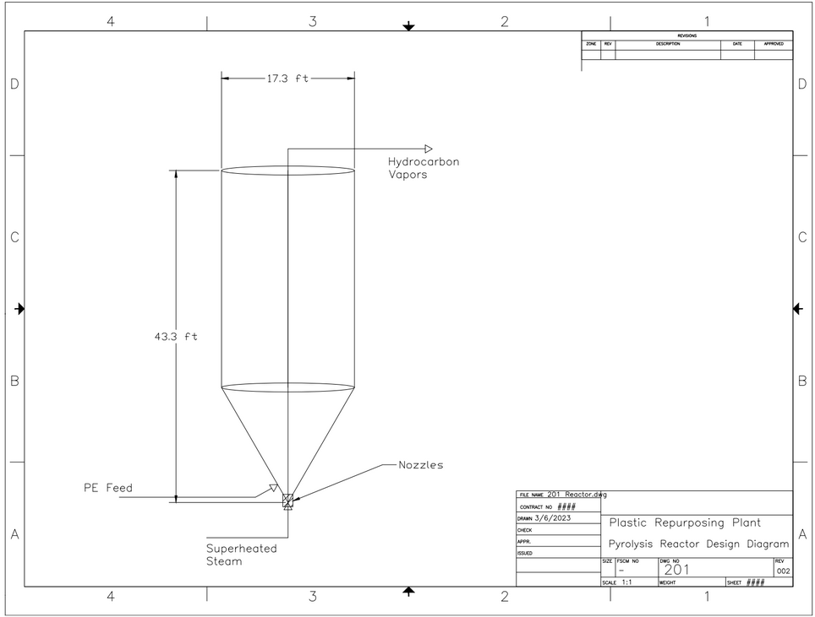
Pyrolysis Reactor
A density of 0.070 lbm/ft³ was assumed for the steam and vapor hydrocarbons in the reactor
Reactor shape is cylindrical with a cone on the bottom section
Steam will be fed through an injector nozzle
Liquid HDPE will be fed through atomizer nozzles
HDPE droplets have high surface area to volume ratio, speeding up reaction
Process Variable | Value
Reactor Pressure | 44 psig
Reactor Temperature | 930 °F (500 °C)
Volume, V | 6,875 ft³
Diameter, D | 17.3 ft
Height, H | 43.3 ft
Steam Pressure | 132 psig
Steam Temperature | 1650 °F (900 °C)
Steam Flow Rate | 265,000 tons/yr
Steam Velocity | 2.0 ft/s
Reactor Height = 43.3 ft
Diameter = 17.3 ft
The ASPEN Plus
May 8th, 2023

Slide 12
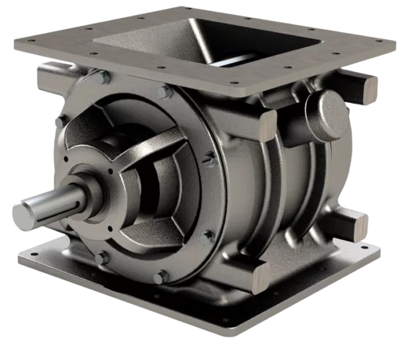
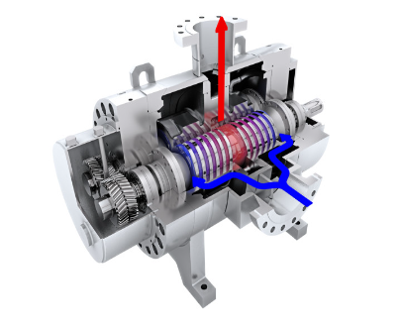
Pre-treatment, Starfeeder, and Screw Pump Heater
We expect to purchase HDPE that has already been cleaned and treated to some degree
Grinder will turn scrap HDPE into more workable pellets
Oxygen cannot be allowed into the reactor with the HDPE feed
Risk of combustion
Starfeeder excludes air from HDPE pellets
ACS C1 Series 16x16” Airlock Rotary Valve
Design capacity meets that needed for our process
HDPE feed into reactor must be a liquid
Screw pump heater will move HDPE pellets into reactor, which will melt as they are heated within the unit
Ci series. (n.d.). ACS Valves. Retrieved May 6, 2023, from https://acsvalves.com/rotary-valves/view/airlock-ci-series
“[Hot Item] Factory Price Progressive Cavity Single Screw Pump for Sewage Sludge / Polymer Chemicals Dosing/Oily Water/Molasses/Food and Other Viscous Liquids.” Xing Long Pump, https://xinglongpump.en.made-in-china.com/product/kwhxWoRHhlcQ/China-Factory-Price-Progressive-Cavity-Single-Screw-Pump-for-Sewage-Sludge-Polymer-Chemicals-Dosing-Oily-Water-Molasses-Food-and-Other-Viscous-Liquids.html.
The ASPEN Plus
May 8th, 2023

Slide 13
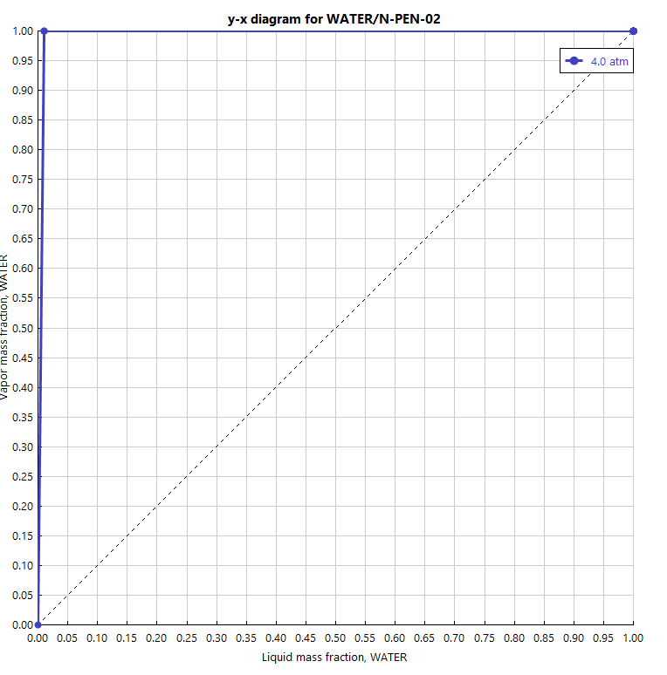
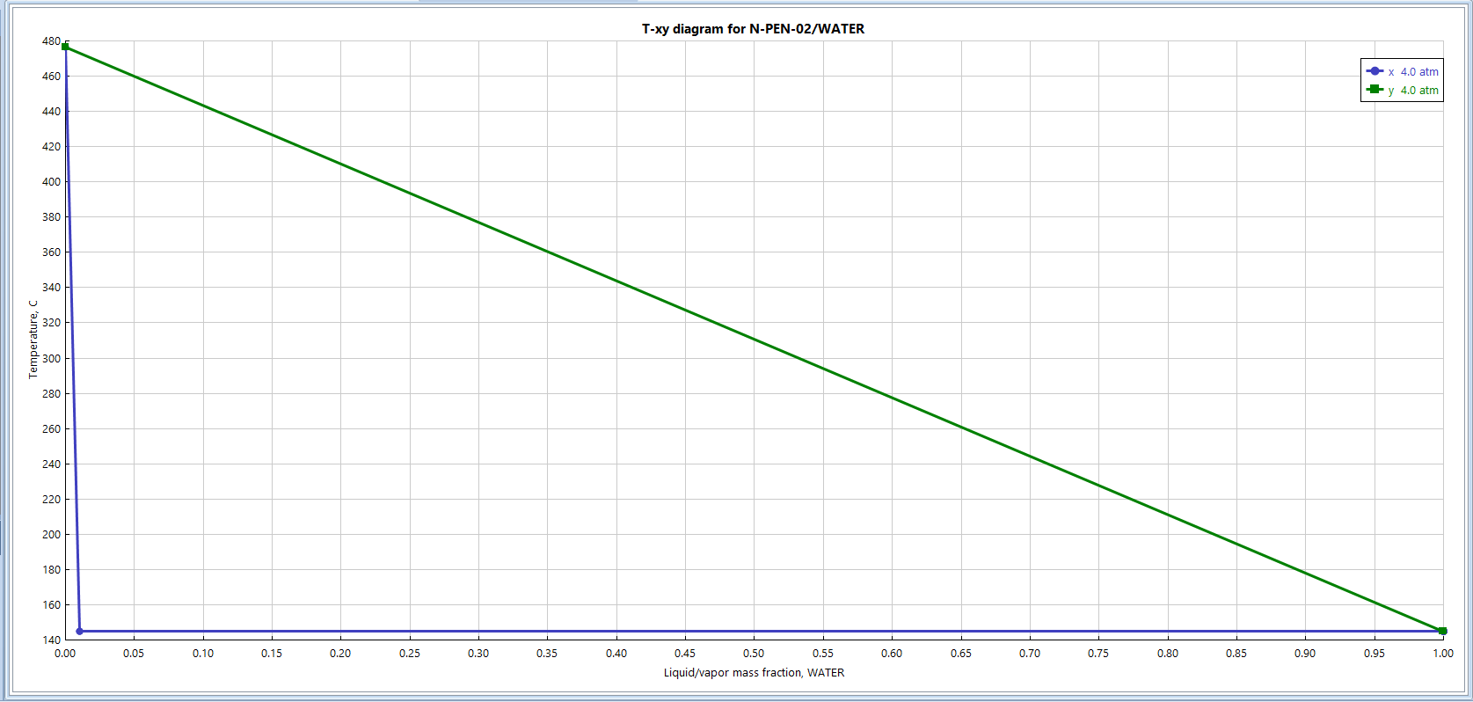
Fractionation Column
Bottoms stream will be wax
Distillate streams include vapor hydrocarbons, liquid hydrocarbons, and water
Feed from reactor is primarily wax and steam
N-pentacostane (C₂₅H₅₂) used to represent waxes
Minimum 2 stages required to separate wax to 99 wt% purity
The ASPEN Plus
May 8th, 2023

Slide 14
Fractionation Column
Instead of a reboiler, the column will have a bottoms cooler
Bottom pump around: wax stream is cooled and sent back into feed stage
Process stream from the reactor will be quenched by liquid bottom pump around
Boil up comes from the superheated feed (@930°F)
Reflux drum will serve as a three-phase separator
Condenser and reflux drum temperature are set at temperature of air coolant + 20°F
Very pure wax can be achieved from the separation
99.61 wt% wax
Pressure | 44 psig
Number of Stages | 3
Feed Stage | 3
Reflux Drum Temperature | 120°F
Reflux Drum Diameter | 3 ft
Reflux Drum Tangent to Tangent | 9 ft
Reflux Drum Elevation | 35 ft
Column Height | 16 ft
Column Diameter | 20 ft
Column Thickness | 0.3125 in
Reflux Rate | 27,900 tons/yr
Pump Around Rate | 585,000 tons/yr
Bottoms Flow Rate | 293,000 tons/yr
Vapor Hydrocarbon Flow Rate | 6,330 tons/yr
Liquid Hydrocarbon Flow Rate | 2,110 tons/yr
Water Flow Rate | 264,000 tons/yr
99.61 wt% wax stream can be obtained from separation
293,000 tons/yr of wax
The ASPEN Plus
May 8th, 2023

Slide 15
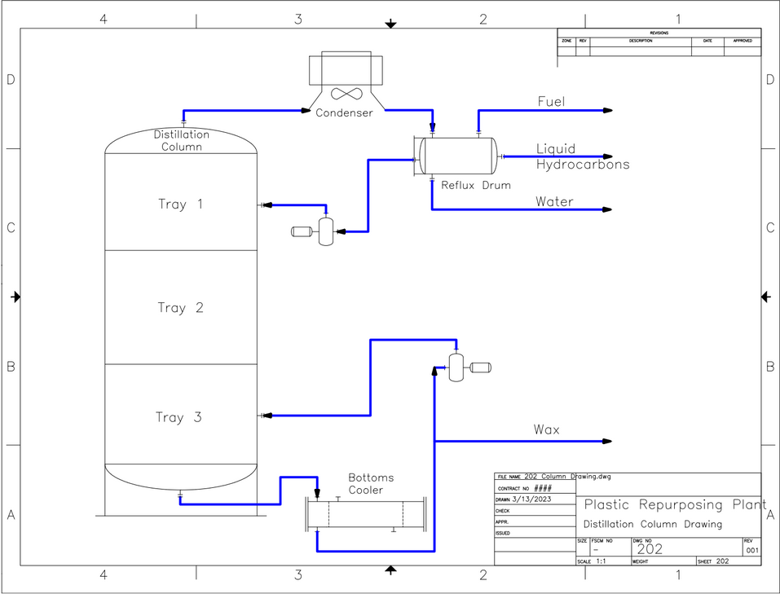
Fractionation Column
Instead of a reboiler, the column will have a bottoms cooler
Bottom pump around: wax stream is cooled and sent back into feed stage
Process stream from the reactor will be quenched by liquid bottom pump around
Boil up comes from the superheated feed (@930°F)
Reflux drum will serve as a three-phase separator
Condenser and reflux drum temperature are set at temperature of air coolant + 20°F
Very pure wax can be achieved from the separation
99.61 wt% wax
99.61 wt% wax stream can be obtained from separation
293,000 tons/yr of wax
The ASPEN Plus
May 8th, 2023

Slide 16
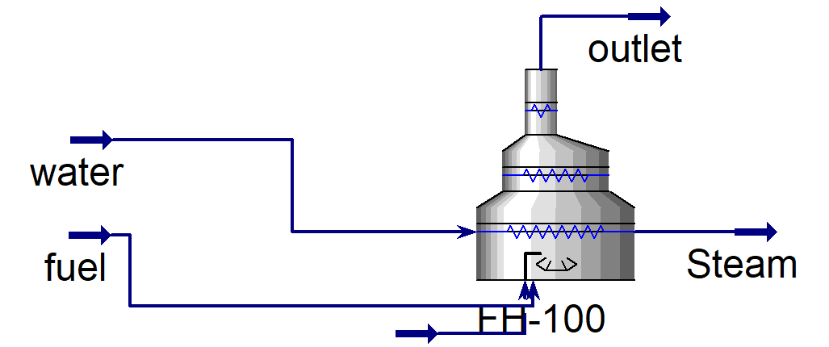
Fired Heater Boiler
Aspen HYSYS was used to model the Boiler (Fired Heater)
Aspen Plus does not have a unique unit for this. RSTOIC with a HEATX unit used in larger Aspen Plus simulation
Heat Load of Boiler: 115 MMBTU/hr
Steam at 1650°F and 10 atm generated
Required total flow rate of fuel determined to be 10,400 lbm/hr
1,440 lbm/hr (6,330 tons/yr) fuel will be provided from the vapor hydrocarbon product
Additional fuel corresponds to yearly fuel cost of $5.3M at a natural gas price of $0.07/lbm ($2.50/1,000 scf)
Flue gas composition and temperature determined
Temperature 1,760°F (compared to 1,690°F from Aspen Plus)
CO₂ production rate: 29,400 lbm/hr (129,000 tons/yr)
Flow Rate | Value
Fuel Inlet Flow Rate | 10,400 lbm/hr (45,500 tons/yr)
Inlet Air Flow Rate | 215,000 lbm/hr (942,000 tons/yr)
Steam Flow Rate | 61,700 lbm/hr (270,300 tons/yr)
Flue Gas Flow Rate | 226,000 lbm/hr (988,000 tons/yr)
The ASPEN Plus
May 8th, 2023

Slide 17
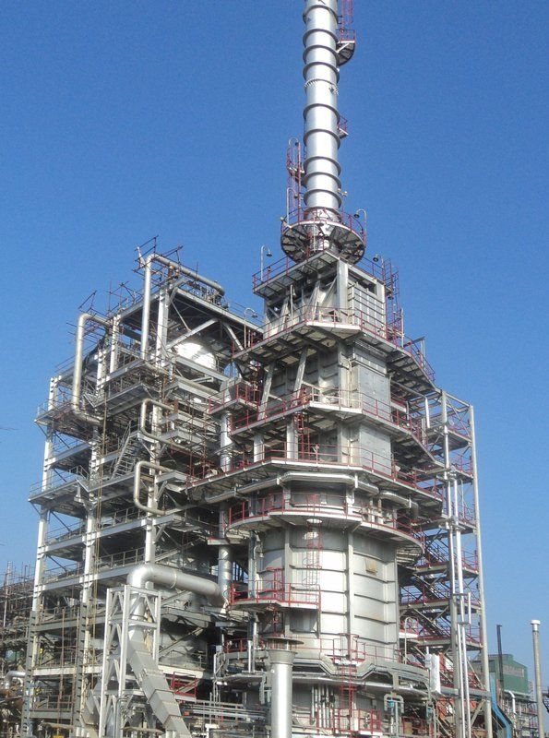
Fired Heater Boiler
The Aspen HYSYS simulation was used to size the boiler unit
Results shown in Table
There are 3 separate sections to the boiler: radiant zone, convective zone, and economizer zone
Process Variable | Value
Radiant Zone Height | 14.0 ft
Radiant Zone Diameter | 6.6 ft
Convective Zone Height | 5.6 ft
Convective Zone Diameter | 4.7 ft
Economizer Zone Height | 38.1 ft
Economizer Zone Diameter | 1.6 ft
Radiant/Convective Zone Thickness | 1.0 ft
Economizer Zone Thickness | 0.33 ft
Total Height | 57.7 ft
Economizer Zone
Convective Zone
Radiative Zone
Fired heaters | esteem projects—The fired heater company. (n.d.). Esteem Projects Pvt. Ltd. Retrieved May 7, 2023, from https://www.esteemprojects.com/fired-heaters
The ASPEN Plus
May 8th, 2023

Slide 18
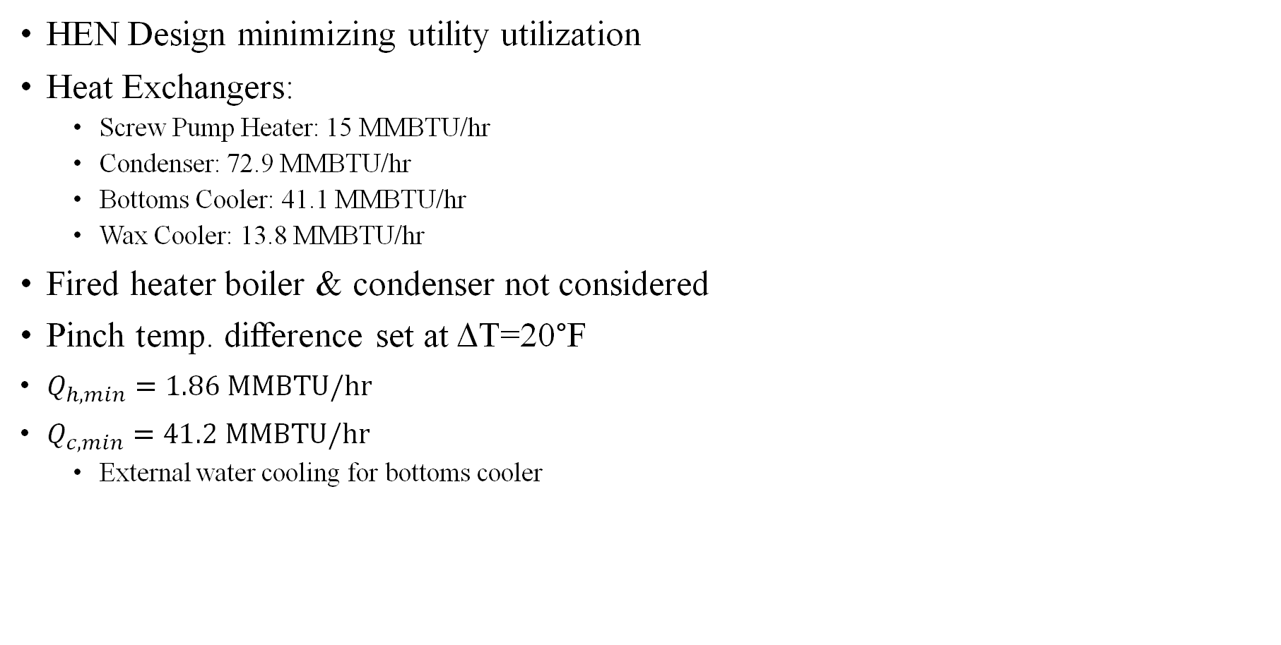
Pinch Technology/Heat Exchanger Network
HEN Design minimizing utility utilization
Heat Exchangers:
Screw Pump Heater: 15 MMBTU/hr
Condenser: 72.9 MMBTU/hr
Bottoms Cooler: 41.1 MMBTU/hr
Wax Cooler: 13.8 MMBTU/hr
Fired heater boiler & condenser not considered
Pinch temp. difference set at ΔT=20°F
$Q_{h,min}=1.86 MMBTU/hr$
$Q_{c,min}=41.2 MMBTU/hr$
External water cooling for bottoms cooler
Heat load of screw-pump can be mostly met by wax & bottoms cooler recovery
The ASPEN Plus
May 8th, 2023
Notes:
Boiler is both a process & utility unit; condenser not considered bc potential issues with operation during startup
Minimum cooling load ~~ heat load of bottoms cooler – significant air cooling necessary regardless of heat recovery
Only the bottoms cooler, wax cooler, and heated wax storage tanks were considered in the HEN analysis.

Slide 19
Materials of Construction (MOC)
Given their operating temperatures and low risk of corrosion, most process units will be constructed out of Carbon Steel (CS)
There will be several exceptions
The fired heater boiler can get up to 1760°F and contains oxygen; therefore, it will be made from SS-309
SS-309 is oxidation resistant up to its maximum temperature
Outlet piping will also be made of SS-309
Reactor will be made of SS-309 as well, since it could reach a similar temperature during start up
Inlet steam at 1650 °F
The column feed is at 930°F; therefore, it will be made of SS-304
Metal costs—Roy mech. (n.d.). Retrieved April 10, 2023, from https://roymech.org/Useful_Tables/Matter/Costs.html
Alloy | Upper Operating Temperature (°F) | Approximate Relative Cost
CS | 650 | 1
SS-304 | 1600 | 4.5
SS-316 | 1700 | 6.5
SS-309 | 1900 | 10
Alloy 309/309s heat resistant stainless steel plate. (n.d.). Sandmeyer Steel. Retrieved April 10, 2023, from https://www.sandmeyersteel.com/309-309S.html
ASM International. (1998). Metals Handbook: Desk Edition, 2nd Edition. ASM International. Page 351.
Boiler and Reactor Constructed out of SS-309
Column Constructed out of SS-304
The ASPEN Plus
May 8th, 2023

Slide 20
Aspen Analysis of Column
N=3 was determined to be the ideal tray count due to low capital costs
Increased stage count does not change the purity or flow rate of bottoms product
Likely due to already very high separation factor between wax and all other components
The effect of the reflux ratio on capital cost and revenue was investigated
Additional product value assumes no downtime
Assume $0.971/lb for wax, $0.22/lb for liquid hydrocarbon
Utility cost similar regardless of reflux ratio
“Tray dried up” error appeared for reflux ratios above 20
Reflux Ratio (mol/mol) | Total Equipment Cost ($) | Total Installed Cost ($) | Bottoms Purity (wt%) | Bottoms Flow Rate (tons/yr) | Liquid Hydrocarbon Flow Rate (tons/yr) | Additional Product Value ($M/yr)
1.13 | 596,700 | 1,787,800 | 0.9961 | 292,740 | 2,110 | 0
0.25 | 623,900 | 1,817,700 | 0.9961 | 280,000 | 15,700 | -18.76
0.37 | 623,800 | 1,817,600 | 0.9961 | 285,000 | 10,400 | -11.38
0.61 | 608,800 | 1,825,400 | 0.9961 | 290,000 | 5,120 | -4.00
1.96 | 611,800 | 1,827,800 | 0.9961 | 293,500 | 1,270 | 1.11
13.7 | 651,400 | 1,912,700 | 0.9957 | 294,000 | 715 | 1.83
16.9 | 644,300 | 1,913,400 | 0.9940 | 294,500 | 127 | 2.55
Reflux Ratio of 2 gives ~$1M/yr additional product value compared to original case without decreasing wax product purity and only ~$50K increase in capital cost
The ASPEN Plus
May 8th, 2023

Slide 21
Aspen Equipment Cost Estimations
Equipment | Equipment Cost ($) | Installed Cost ($)
Grinder** | 223,000 | 892,000
Auger Conveyer* | 48,900 | 196,000
Conveyer Motor* | 1,200 | 4,800
Starfeeder** | 10,000 | 40,000
Screw Pump Heater** | 50,000 | 200,000
Pyrolysis Reactor | 2,830,000 | 3,550,000
Fractionation Column | 448,000 | 1,380,000
Reflux Drum | 41,600 | 155,000
Boiler (2)* | 4,950,000 | 19,800,000
Condenser | 69,600 | 255,000
Bottoms Cooler | 60,600 | 254,000
Wax Product Cooler | 27,600 | 201,000
Reflux Pump (2) | 13,920 | 99,500
Pumparound Pump (2) | 21,750 | 145,000
Column Water Pump (2) | 16,820 | 123,000
Liquid Hydrocarbon Pump (2) | 13,050 | 84,40
Wax Pump (2) | 19,140 | 126,000
Makeup Pump (2) | 12,470 | 87,000
Recycle Pump (2) | 12,470 | 83,800
Flare** | 21,000 | 21,000
De-oiler (2)** | 152,000 | 608,000
Reverse Osmosis Unit (2)** | 200,000 | 800,000
Aspen Process Economic Analyzer Used to estimate equipment costs
For those units which did not exist in Aspen Plus, the FACT Method was used
Boiler, Conveyer
If neither could be used, costs were estimated based on commercially available models
Starfeeder, Screw pump heater
Aspen Estimates are in 2013 dollars
CEPCI Index of 1.45 used to adjust for inflation
*Costs determined based on the FACT Method
**Costs determined based on commercially available units
The ASPEN Plus
May 8th, 2023

Slide 22
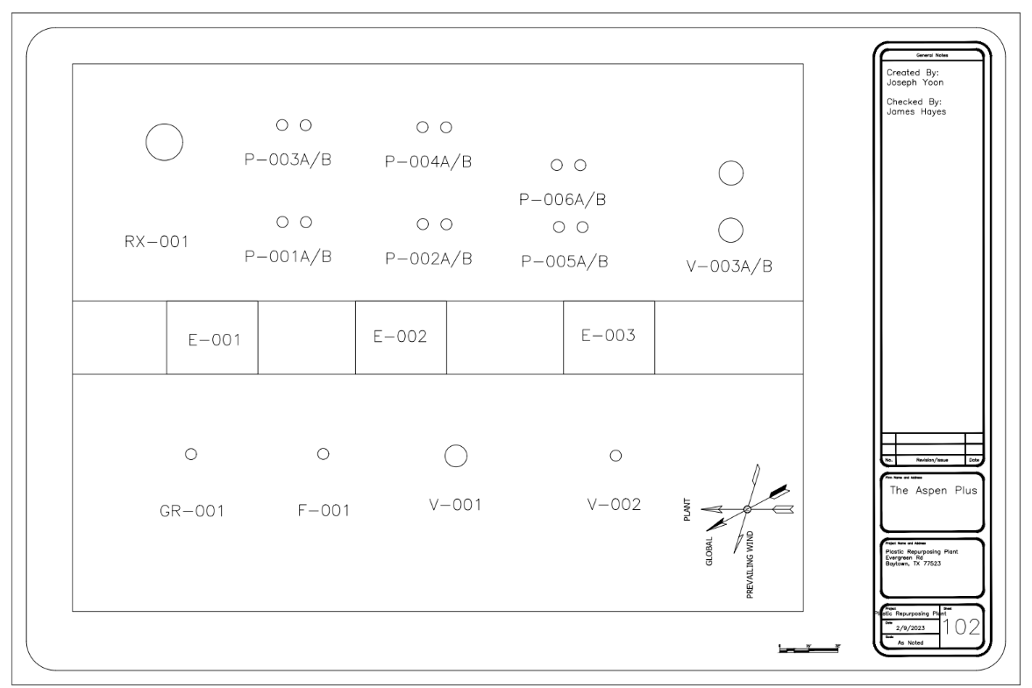
Final Plant Layout (ISBL)
ID | Unit
RX-001 | Pyrolysis Reactor
P-001A/B | Screw Pump Heater
P-002A/B | Pump Around Pump
P-003A/B | Reflux Pump
P-004A/B | Liquid Hydrocarbon Pump
P-005A/B | Column Water Pump
P-006A/B | Wax pump
E-001 | Bottoms Cooler
E-002 | Condenser
E-003 | Wax Cooler
GR-001 | Grinder
F-001 | Starfeeder
V-001 | Fractionation Column
V-002 | Reflux Drum
V-003 | Boiler
TK-008 | Deoiler
TK-009 | Reverse Osmosis Unit
The ASPEN Plus
May 8th, 2023

Slide 23
ISBL Considerations
Adequate Spacing for Safety
Examples:
Column to Reactor requires enough space for personnel and maintenance
Storage tanks must be 100 ft away from column, reactor and truck loading
Arranged linearly with the earliest steps of the process being left most and the later steps being on the right.
Easier to isolate problems and troubleshoot problems
All piping will go through the pipe rack
Clears floor space and potential tripping hazards
Allows for quick maintenance
Promotes organization
Placed next to raw PE loading and Storage tanks for short transportation times.
The ASPEN Plus
May 8th, 2023

Slide 24
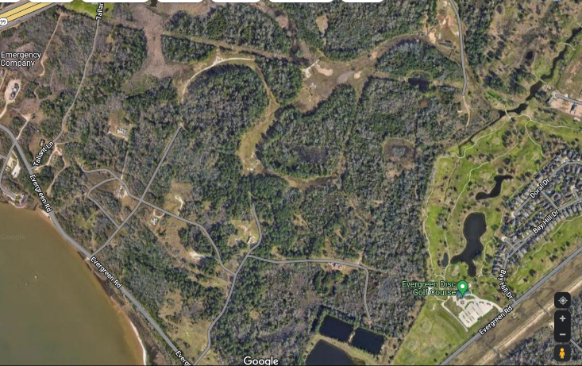
Final Plant Layout
Chosen location is on the east bank of the Houston Ship Channel, on Evergreen Rd, Baytown, TX 77523
Coordinates: 29°42'36.4"N 94°58'11.5"W
Up to about 0.5 mi² (320 acres) of open area could be available in this plot of land.
The cost of land around the Houston Ship channel is typically around $100-130K/acre or greater.
Ultimately, only around 13.5 acres were used in the plot plan
The ASPEN Plus
May 8th, 2023

Slide 25
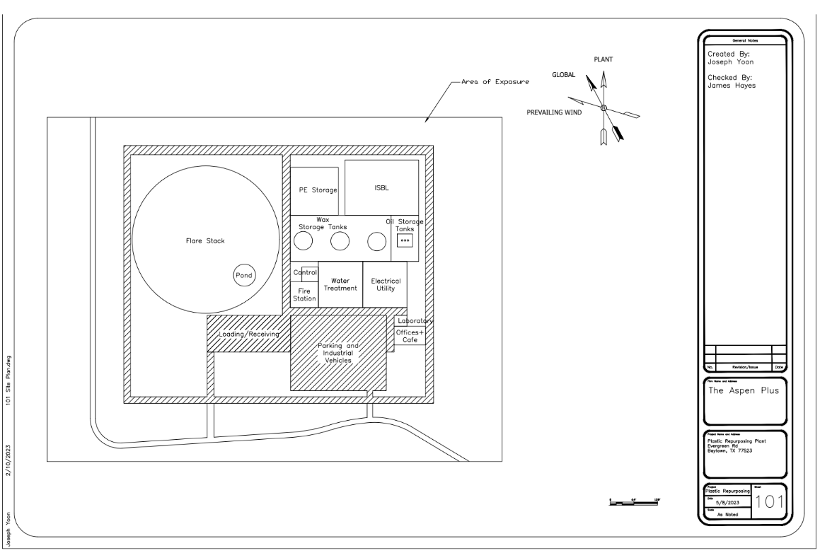
Final Plant Layout (OSBL)
The ASPEN Plus
May 8th, 2023

Slide 26
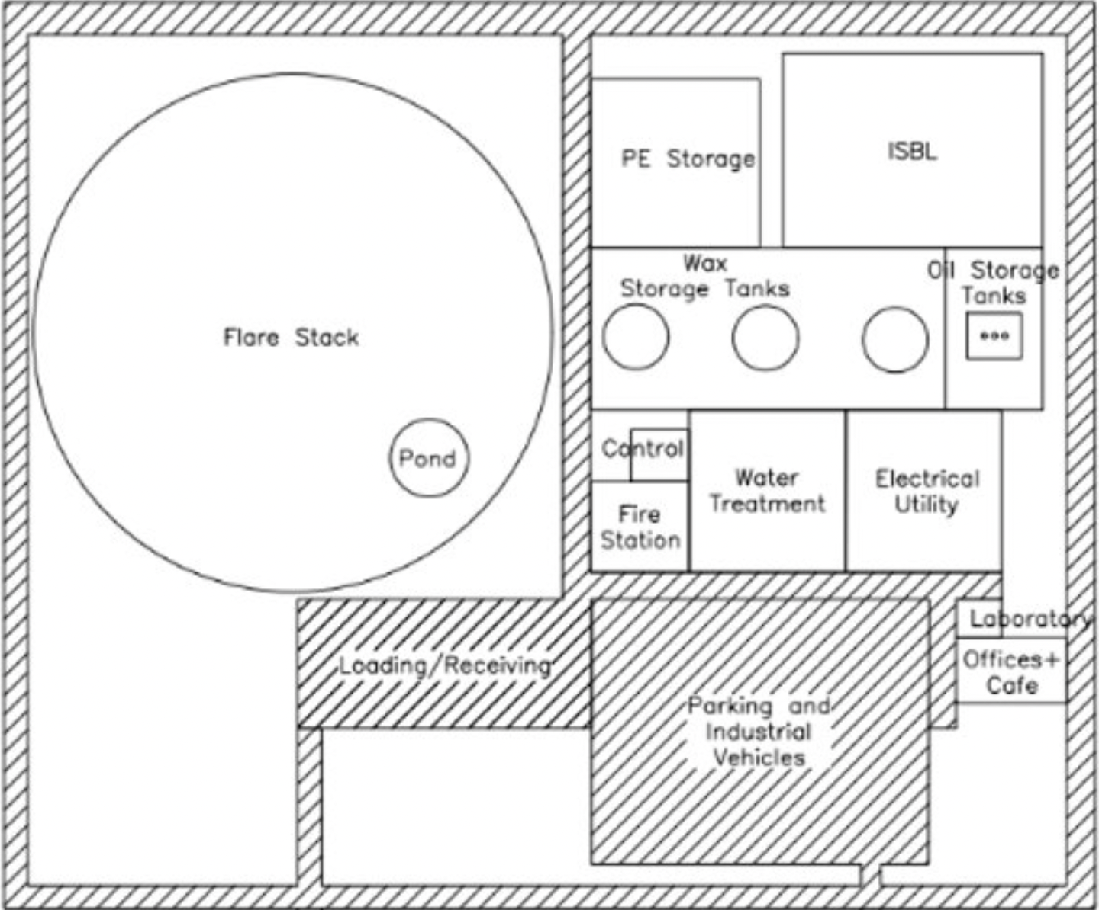
OSBL Breakdown
Components include...
Raw Material Storage
Fire Station
Personnel Related Buildings
Offices
Laboratory
Cafeteria
Power/Utility
Storage Tanks
Product Loading
The ASPEN Plus
May 8th, 2023

Slide 27
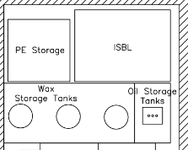
Raw Materials & Intermediates
Daily or weekly usage rates
Polyethylene: 11.5 million lbs/week; 1.65 million lbs/day
Storage unit size
Polyethylene: Warehouse storage (0.35 acres with a height of 30ft)
10 days' worth of HDPE feed will be stored (265,000 ft³)
Re-order quantities
Shipments of HDPE range between 20,000 and 40,000 lbs, equivalent to approximately 60 trucks per day
Location and storage conditions
Since our PE will be fed through an airlock star-feeder to remove moisture and air, there is no need to control the humidity in the storage environment.
The ASPEN Plus
May 8th, 2023
Notes:
Just a quick review, went through most in week 8

Slide 28
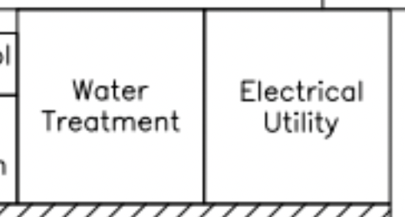
OSBL Electrical/Utility Breakdown
Utility | Cost | Demand | Yearly Cost
Municipal Water | $0.0215/gal | 121,000 tons/yr | $699,000
Electricity | $0.14/kWh | 252 kW | $309,000
Steam | N/A | 270,000 tons/yr | N/A
Natural Gas | $0.07/lbm ($2.5/100scf) | 10,400 lbm/hr (45,500 tons/yr) | $5,270,000
N₂ Gas | $0.47/m³ | 295,000 m³/yr | $139,000
The ASPEN Plus
May 8th, 2023

Slide 29
Storage Tanks
There will be 3 tanks each for the wax and liquid hydrocarbon products
Wax tank will be heated with steam coils to maintain the wax as a liquid at 150°F
Wax tank will also have fiberglass insulation
Nitrogen blanketing on wax tank to prevent oxidation or discoloration of product
Tank | Wax | Liquid Hydrocarbon
Tank Type | Fixed Roof | Floating Roof
Blanketing | N₂ | None
Number of Identical Tanks | 3 | 3
Capacity (gal) | 712,000 | 5,920
Height (ft) | 48 | 16
Diameter (ft) | 50 | 7.9
Operating Temperature (°F) | 150 | 100
Material of Construction | CS | CS
The ASPEN Plus
May 8th, 2023

Slide 30
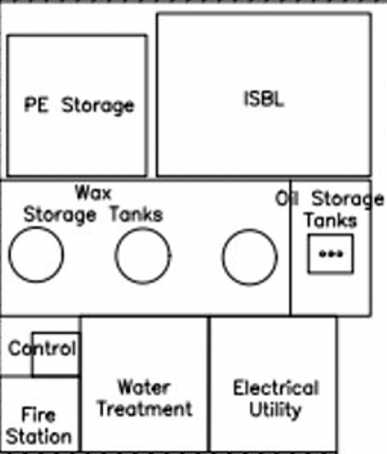
Spill/Leak Prevention
Spill prevention will consist of a bund placed around the liquid storage area (marked by red border).
Sizing of this bund will be as followed
Total Vol. = 1.1*Largest Tank Vol.
Height of Bund = Total Vol. / Bund Area
Volume of Bund = 783,000 gallons
Height of Bund = 2 ft
Area of Bund = 52,300 ft² (1.20 acres)
The ASPEN Plus
May 8th, 2023

Slide 31
Finished Goods
We have two products to ship out:
Wax
Liquid hydrocarbons/synthetic crude oil
Distribution Channels
Wax & synthetic crude oil, they will be transported via tanker trucks. Locomotive transportation is far more expensive than transport via heated and insulated tanker trucks, so we will only be considering potential customers within a tanker truck range from our plant (<1000 mi).
Truckloads (40,000-45,000 lbs per truckload)
Wax: ~15,000 Truckloads per year, 40 Truckloads per day
Synthetic Crude Oil: ~70 Truckloads per year, 1-2 Truckloads per week
Based on quotes from local trucking companies, we estimate our transportation costs to be ~$12.3M per year
The ASPEN Plus
The ASPEN Plus
May 8th, 2023
31

Slide 32
Environmental Considerations
Air Emissions (All fall under attainment/unclassifiable in Houston, TX)
Volatile Organic Compounds (VOCs) (benzene, toluene, etc)
Recovering and selling benzene and toluene as oil product
Other VOCs will be recovered and sent to boiler
Some fugitive emissions of methane, ethylene, ethane, etc. are possible
Carbon Dioxide (CO₂)
29,400 lbm/hr (129,000 tons/yr) in flue gas
EPA NSPS 40 CFR Part 98 requires us to report this to the EPA
Relative to the 53 million tons of CO₂ emitted in the Houston area, this is somewhat low
Can investigate modern carbon capture and storage technology at a later stage
Nitrogen Oxides (NOx), Sulfur Oxides (SOx),
HDPE feed is already highly processed, so unlikely that combustion of products would release NOx or Sox during complete combustion
Incomplete combustion could produce NOx
Natural gas feed could only present issue if it is low quality
Particulate Matter
Potential CO or elemental C from incomplete combustion in boiler
Continuing with our complete combustion assumption, the production of particulate matter is negligible
The ASPEN Plus
May 8th, 2023
“Texas Commission on Environmental Quality's 2019 State of the Air Report.” Texas Commission on Environmental Quality Control, 2019.
Notes:
Attainment/unclassifiable means the air quality is at or above the national with respect to each pollutant

Slide 33
Environmental Considerations
Hazardous wastes and materials
The only waste posing hazards is that which is emitted into the air in flue gas and small amounts of liquid hydrocarbons/synthetic crude oil in water
Most hydrocarbons present in the water stream will be removed via the de-oiler unit
Most hydrocarbons will be separated and stored as wax and liquid hydrocarbon, or used as fuel
Synthetic crude oil is flammable, posing significant risk to our facility
Following process safety protocols and proper maintenance is imperative to preventing spills/leaks or accidents
Process Waste Effluent Water
Potential for low concentrations of pentane, benzene, toluene, and wax in water purge stream
Will be tested for these contaminants in water treatment facility prior to discharge
Permit required with the Texas Commission on Environmental Quality to determine specific limits
Storm water runoff in pond will also be tested before runoff is allowed to flow to ship channel
Hazards posed by synthetic crude oil will be managed by internalized process safety protocols
The ASPEN Plus
May 8th, 2023
Notes:
Higher Carbon Chains = the off specification wax

Slide 34
Process Control Objective (PCO_1-3)
Objectives by Unit Operation
Fractionation Column – 3 streams separated from product mixture
Bottoms Wax Stream – ≥99.3 wt% purity
Reflux Drum (3-phase separator)
Safely separate liquid component from vapor hydrocarbons
Safely separate synthetic crude oil from water
Reactor
Maintain outlet temperature of 930°F (500 °C)
Overall: maintain strict product purity standards and prevent dangerous operating conditions
The ASPEN Plus
May 8th, 2023

Slide 35
Process Control Strategies (PCS_1)
Fractionation Column Control
Temperature
Measure and control the temperature of each tray to maintain vapor-liquid equilibrium (VLE)
Pressure
Measure/control the intended column pressure of 44 psig to maintain VLE
Flow
By controlling the flow rates within the column, the residence time can be optimized, which improves separation efficiency and thus product stream purity
Bottoms Cooler
Monitoring and controlling the temperature, the boiling points of components can be controlled, maintaining purity of product streams
These strategies will intertwine to ensure the column does not run dry, to ensure top product quality, and to maintain the temperature purity relationship
The ASPEN Plus
May 8th, 2023

Slide 36
Process Control Loop: Fractionation Column (PCL_1)
Temperature
Thermocouple within feed tray will communicate any deviations from the desired temperature and send a signal to a flow controller placed on the water stream in the bottom's cooler. Flow controller will adjust control valve on water stream to increase cooling rate, as necessary.
Pressure
Pressure Gauge will be placed at the vapor outlet and will communicate deviations with a pressure. This controller will then adjust the rate of condensation by increasing the rate of air cooling.
Flow
A flow controller paired with a control valve will be placed on the feed line going into the column to maintain constant flow.
Level
A level controller will be placed in the distillation column and will communicate any deviations to a flow controller placed on the wax product stream. A control valve will then be adjusted to increase or decrease outward flow of wax.
The ASPEN Plus
May 8th, 2023

Slide 37
Process Control Strategies (PCS_2)
Reflux Drum Control
Level
Monitoring and controlling the overall liquid level in the drum maintains the separation efficiency occurring at the interface by controlling the concentration gradient in the bulk liquids
Adjusting this level to optimize residence time of the drum optimizes efficiency
Temperature
Monitoring and controlling the temperature within the drum ensures the oil and water aren’t unnecessarily mixed by maintaining constant density and viscosity of the liquids
Flow
Control of flow rates in and out of the drum ensure the desired separation efficiency can be achieved
Interface level
Further control of the separation efficiency can be achieved by measuring and controlling the interface level in addition to overall level
These strategies will ensure the desired separation efficiency is reached, and accordingly product purity standards are maintained
The ASPEN Plus
May 8th, 2023

Slide 38
Process Control Loop: Reflux Drum (PCL_2)
Temperature
To maintain temperature in the reflux drum, a thermocouple will be placed and will communicate deviations with the air cooler to increase or decrease cooling rate.
Flow
A pressure controller will be placed and will communicate with a flow controller on the fuel gas stream. A control valve will be varied by the flow controller to increase/decrease fuel gas outlet stream.
Level
A level controller placed at the interface will be used to communicate liquid level with a flow controller and valve on the water outlet stream. If the liquid level is too high/low the valve will adjust accordingly.
The ASPEN Plus
May 8th, 2023

Slide 39
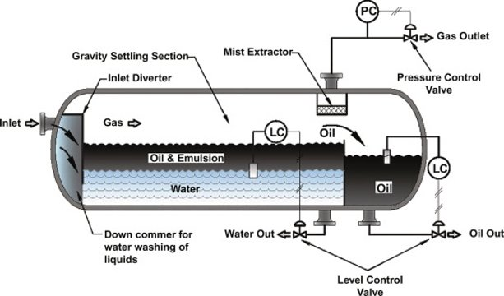
Process Control Loop: Reflux Drum (PCL_2)
Stewart, M. (2021). 13—Above ground storage tanks. In M. Stewart (Ed.), Surface Production Operations (pp. 677–776). Gulf Professional Publishing. https://doi.org/10.1016/B978-0-12-803722-5.00013-6
The ASPEN Plus
May 8th, 2023

Slide 40
Process Control Strategies (PCS_3)
Reactor Control
Temperature
Monitoring and controlling the temperature in the reactor maintains a consistent product yield and prohibits thermal degradation of product streams
Can be controlled by varying the amount of raw feed within the reactor at any one time
These strategies will ensure safe operating conditions, and that our target conversion is reached to acquire the desired product yield
The ASPEN Plus
May 8th, 2023

Slide 41
Process Control Loop: Reactor (PCL_3)
Temperature
Thermocouples distributed throughout the reactor, connected to a transmitter and controller which determines the amount to adjust the final control element, the current of the modular starfeeder
When the temperature drops below 480°C, the star feeder will be sent a lower current and reduce the mass flow of raw PE, increasing the temperature of the reactor.
Above 520 °C, a higher current will be sent to the star feeder and the mass flow will increase, decreasing the temperature within the reactor.
Conveyer speed must adjust as well
The ASPEN Plus
May 8th, 2023

Slide 42
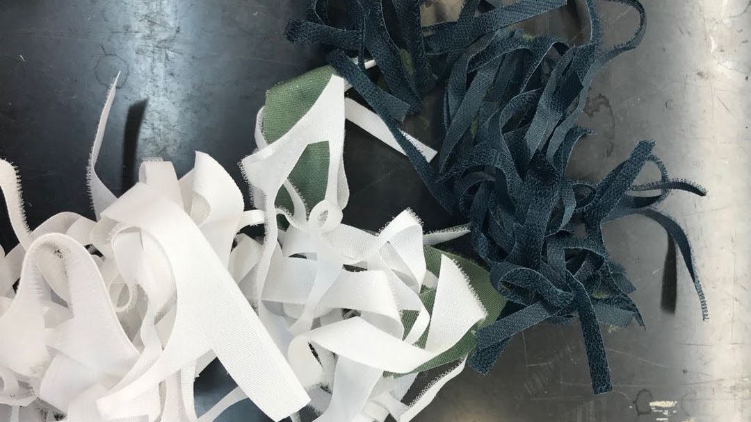
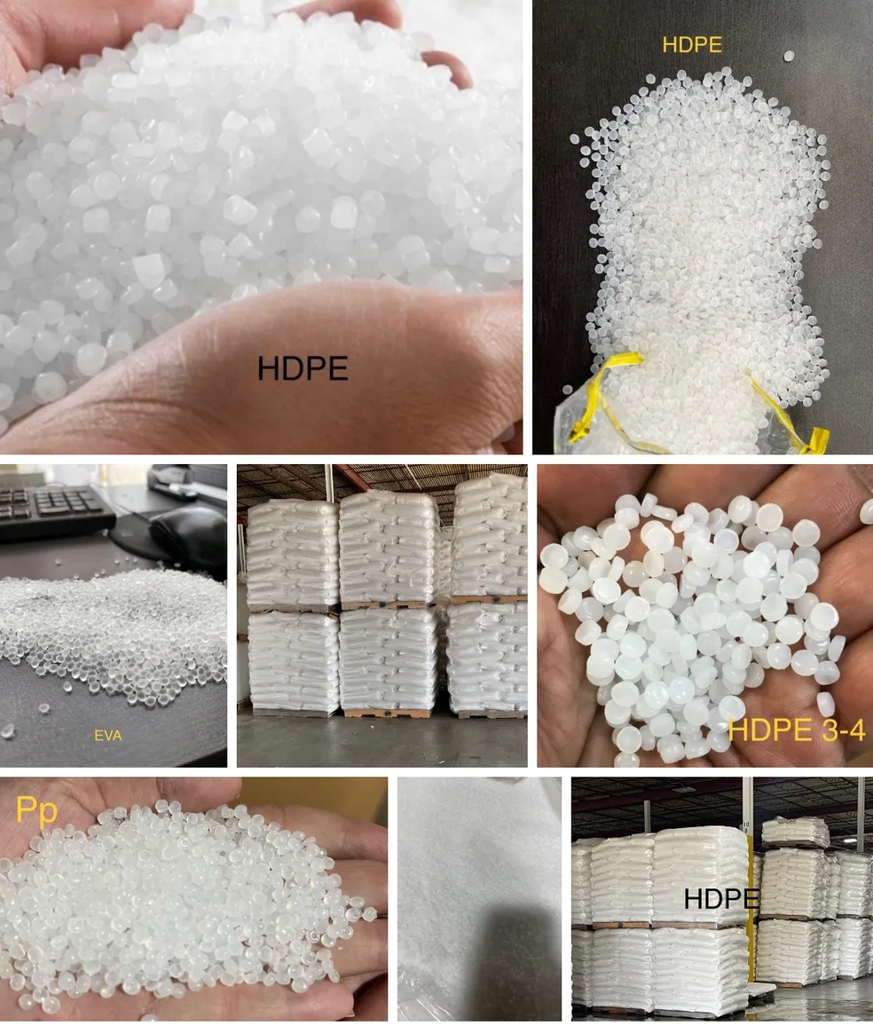
HDPE Feedstock Market
Worldwide Distribution USA
Coldsprings, TX – Recycled Plastics Distribution
$.32/lb at 40,000 lbs for mixed, scrap HDPE
$.45/lb at 20,000 lbs for refined scrap
De-Two Trading Inc.
Recycling center selling HDPE milk bottles
Quote: $.39/lb at 10,000 lbs
Tarquin Polymers & Colors
Polymers & Chemical Production - Sugar Land, TX
Sell recycled HDPE at $.46/lb at 30,000 lbs
Polyethylene Feed will cost around ~$.40-.45/lb across different suppliers
The ASPEN Plus
May 8th, 2023
Notes:
WWD USA has 5 other centers across the USA that can quote us at same price +transportation cost
Recycled – Different colors, recycled HDPE products
Refined – scrap from HDPE production process

Slide 43
Wax Product Market
Paraffin wax is commonly used in the manufacturing of candles, cosmetics, and coatings-related products
Potential customers identified include:
Packit Gourmet – Specialty foods producer (freeze-dried, camping foods). Packaging uses paraffin wax, located in Austin TX, 200 mi from our plant.
Texas Food Pack – Food packaging manufacturing and distribution company. Make many cups, paper plates, wraps and boxes that use paraffin wax. Manufacturing plant in Dallas TX, 270 miles from our plant
Mary Kay – Global cosmetics manufacturer, headquarters and manufacturing plant located in Dallas, TX. Produces skin lotions, lipsticks, and lip balms that contain paraffin wax as an emollient for its moisturizing/conditioning properties on the skin. 280 miles from our plant.
Paraffin wax is common in several industries, we expect to sell our product at a price of $0.97/lb
The ASPEN Plus
May 8th, 2023
Notes:
WWD USA has 5 other centers across the USA that can quote us at same price +transportation cost
Recycled – Different colors, recycled HDPE products
Refined – scrap from HDPE production process

Slide 44
Synthetic Crude Oil Product Market
Most commonly used in oil refineries and olefins plants
Many of these plants exist in the Houston area
Exxon has both just 5 miles from our plant location
SCO is typically produced from upgrading bitumen, assume same market as our product
Current SCO price: $0.22 /lb
This represents a small fraction of our annual output, and thus a small effect on overall plant economics
We expect to sell our synthetic crude-oil product at a price of ~$0.22/lb
The ASPEN Plus
May 8th, 2023
Notes:
WWD USA has 5 other centers across the USA that can quote us at same price +transportation cost
Recycled – Different colors, recycled HDPE products
Refined – scrap from HDPE production process

Slide 45
SWOT Analysis
Strengths (Internal factors that are positive for the project) Lean production Structured workforce Technological skills Purity of wax product | Weaknesses (Internal factors that are negative for the project) Employee health problems Inability of product diversification High carbon footprint and pollution
Opportunities (External factors that have the potential to benefit the project) Decrease in waste PE costs Close proximity of other petrochemical plants Abundant water resources Strong local market potential for wax and liquid hydrocarbons | Threats (External factors that are a potential detriment to the project) Natural disasters Fluctuating market prices Increase in waste PE costs Decrease in wax prices Tax increases New laws restricting production
High wax purity, strong wax market, low PE prices reflect benefits of this project
The ASPEN Plus
May 8th, 2023

Slide 46
Project Schedule
Specialized process units will cause procurement and construction periods to be long (over 1 year)
The pyrolysis reactor will take particularly long as it must be made unique for our process, and out of the uncommon SS-309 alloy
3-year duration from FEL2 to Start-up
The ASPEN Plus
May 8th, 2023

Slide 47
Final Economic Analysis
OPEX | Cost ($M/yr)
Labor | 15.2
Maintenance | 0.96
Property Tax | 0.08
Insurance | 1.1
Electrical Utility | 0.31
Water Utility | 0.70
N₂ Gas | 0.14
Transportation | 12.3
Natural Gas Fuel | 5.3
Total OPEX | 36.1
CAPEX | Cost ($M)
Total ISBL | 27.7
Wastewater Treatment Facility | 1.4
Product Storage Tanks | 18.7
PE Storage Warehouse | 0.5
Other OSBL | 9.7
Total Project Cost | 58.0
Total Project Cost w/ Contingency | 81.1
Estimated total CAPEX with 40% contingency is $81.1M
Estimated total OPEX is $36.1M/yr
The ASPEN Plus
May 8th, 2023

Slide 48
Final Economic Analysis
Working Capital Assumption
5% of total CAPEX
Assumed inflation rate of 5%
Construction Time: 3 yrs
Corporate Tax Rate: 21%
Base case DCFROR: 31.95%
Waste PE Price to achieve after-tax DCFROR of 15%: $0.585/lb (Current Price ~$0.45 /lb)
We recommend to proceed to a FEL-3 study of the process.
The ASPEN Plus
May 8th, 2023
Notes:
Inflation: +/- 10% means 4.5 and 5.5%

Slide 49
Final Economic Analysis
How does overall throughput affect our cashflow?
Fluctuations in throughput can have a large affect on overall cashflow
Similar level of magnitude as CAPEX/Construction Time
Operating Capacity | DCFROR | Cash Flow ($M/yr)
85% | 7% | 84.8
90% | 16.5% | 99.6
95% | 26.1% | 114.4
105% | 43.4% | 144.0
Minimizing production losses/delays maximizes our cash flow
The ASPEN Plus
May 8th, 2023
Notes:
Somewhat obvious point but illustrated quantitatively

Slide 50
Final Economic Analysis
NPV shown assumes 20-year project life and discount rate of 15%
Items (20-years) | Value
Feedstock | $260M/yr
Product Sales | $482M/yr
NPV | $1,087M
Annual Cash Flow after 20 years: $187M
NPV: $1,087M
The ASPEN Plus
May 8th, 2023

Slide 51
Conclusions
We recommend to move ahead with FEL-3 study
Waste PE Price to achieve after-tax DCFROR of 15%: $0.59/lb
Current prices below $0.45/lbm
Wax focused product distribution allows for high profit margin due to its strong market and high prices
Product/feed prices, CAPEX, construction time, and throughput are the most significant factors on DCFROR
Further investigation should be done on the topic of the lab pyrolysis data scaling up to our intended capacity
Recommendation: Move ahead with FEL-3
The ASPEN Plus
May 8th, 2023

Slide 52
Questions?

Slide 53
Final Economic Analysis
The ASPEN Plus
May 8th, 2023

Slide 54
Final Economic Analysis
Graphs didn’t change much, but demonstrate how to achieve 15% DCFROR for different economic scenarios
The ASPEN Plus
May 8th, 2023

Slide 55
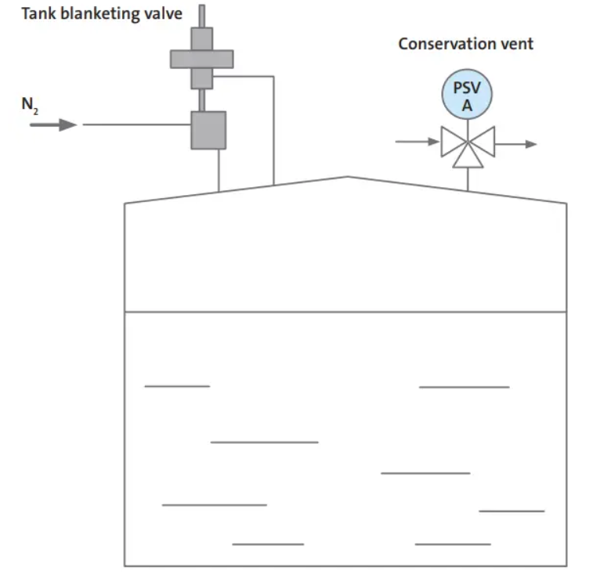
Nitrogen Blanketing
Product enters the wax storage tank
Pressure valve opens to allow N₂ gas to vent to atmosphere
Volume and pressure required for a storage pressure vessel are too high to implement a cost-effective recycle of N₂
Product leaves the wax storage tank
Valve opens to allow N₂ gas into the tank
Dey, A. K. (2022, March 28). What is nitrogen blanketing? Purpose, procedure, and applications of nitrogen blanketing(Pdf). What Is Piping. https://whatispiping.com/nitrogen-blanketing/
The ASPEN Plus
May 8th, 2023

Slide 56
Finished Goods
Storage tanks for finished goods (10 production day’s worth of each)
Stored quantity: 16 million lbs. of wax, 115,000 lbs. of synthetic crude oil
Wax product: 3 tanks
712,000 gal each
Diameter = 50 ft, Height = 48 ft
Oil product: 3 tanks
5,920 gal each
Diameter = 7.9 ft, Height = 16 ft
Vapor hydrocarbon product will not be stored
Used as fuel gas
Potential customers identified in DBM
The ASPEN Plus
May 8th, 2023

Slide 57
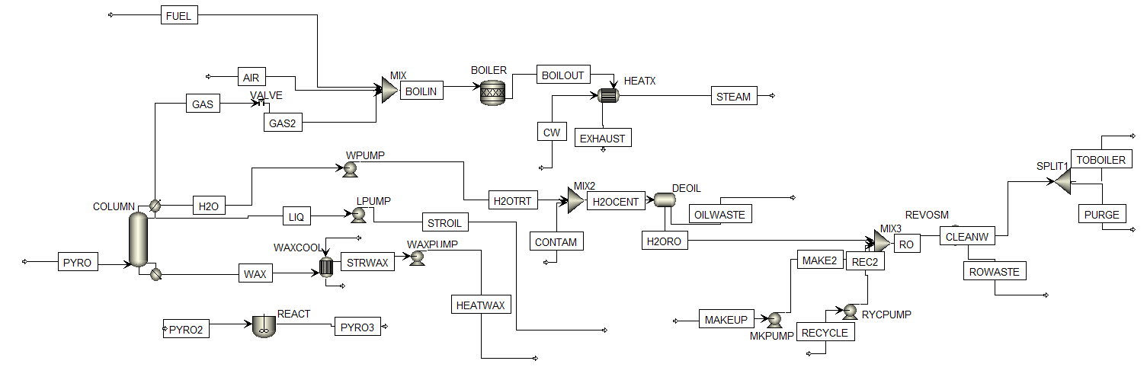
Aspen Plus Simulation
Wastewater treatment section modeled in Aspen Plus simulation
De-oiler hydro cyclone and reverse osmosis (RO) units
Cyclone unit exists but cannot be used for oil-water mixtures, so generic separator unit used instead
No fired heater unit in Aspen Plus
Reactor unit with complete combustion and heat exchanger used to model
The Peng-Robinson equation of state used in simulation
The ASPEN Plus
May 8th, 2023

Slide 58
Flare: Design Philosophy
If pressure in reflux drum exceeds 15 psig of normal operating condition, vapor hydrocarbon will be sent to flare
Vent on the top of the reflux drum
Up to 1,440 lbm/hr (6,330 tons/yr) of vapor hydrocarbon could need to be sent to flare
Assume emissivity of 0.13
Assume 1 psig pressure drop along piping to flare
Average wind speed 12.8 mph, round up to 15 mph
Nomograms were used to calculate Flare Tip Diameter and Flare Height
NAO Inc. for height
Surface Production Operations for tip diameter
The ASPEN Plus
May 8th, 2023

Slide 59
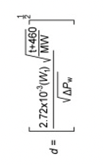
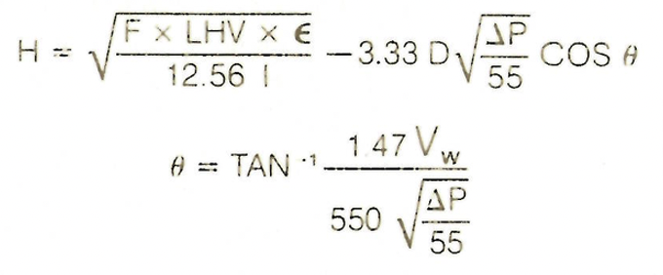
Flare: Design Philosophy
Process Variable | Value
Molecular Weight | 44.0
Temperature (F) | 130.
Pressure Drop (IN. of H2O) | 27.0
Gas Flow Rate (lbm/hr) | 1,400
Nominal Tip Diameter (IN.) | 2.0
LHV (BTU/lb) | 19,500
Emissivity | .13
Wind Speed (mph) | 15.0
Flare Height (ft) | 21.0
Nominal Tip Diameter (in.)
Flare Height (ft.)
The ASPEN Plus
May 8th, 2023

Slide 60
Aspen HYSYS Simulation
Heat Load of Boiler: 115 MMBTU/hr
Steam at 1,650°F and 132 psig (10 atm) is generated
The Aspen HYSYS simulation was used to size the boiler unit
Results shown in Table
There are 3 separate sections to the boiler: radiant zone, convective zone, and economizer zone
Aspen HYSYS unable to estimate cost of this unit
We are looking into vendor quotes
Process Variable | Value
Radiant Zone Height | 14.0 ft
Radiant Zone Diameter | 6.6 ft
Convective Zone Height | 5.6 ft
Convective Zone Diameter | 4.7 ft
Economizer Zone Height | 38.1 ft
Economizer Zone Diameter | 1.6 ft
Radiant/Convective Zone Thickness | 1.0 ft
Economizer Zone Thickness | 0.33 ft
Total Height | 57.7 ft
Economizer Zone
Convective Zone
Radiative Zone
The ASPEN Plus
May 8th, 2023

Slide 61
Employees and Labor Costs
Updates
Laborers for feedings bails of HDPE into process
Clarified which roles are on shift schedule
Modified 8/5 shift schedule used
4 different teams rotate
Role | Number (per shift) | Unburdened Wage ($/hr) | Burdened Wage ($/hr) | Cost ($/yr)
HR | 2 | 60 | 90 | 374,000
Administrator | 2 | 60 | 90 | 374,000
Secretary | 2 | 30 | 45 | 187,000
Janitor | 2 | 20 | 30 | 125,000
Senior Engineer/Project Leads | 3 | 90 | 135 | 842,000
Process Engineer | 4 | 60 | 90 | 749,000
Contact Engineer | 4 | 60 | 90 | 861,000
Mechanical Engineer | 1 | 60 | 90 | 187,000
Senior Process Designer | 1 | 90 | 135 | 280,000
Process Designer | 2 | 60 | 90 | 374,000
Product Development | 2 | 60 | 90 | 374,000
Quality | 3* | 40 | 60 | 1,576,800
Marketing | 3 | 50 | 75 | 468,000
Accounting | 3 | 50 | 75 | 468,000
Operator | 4* | 60 | 90 | 3,153,600
Maintenance | 3* | 40 | 60 | 1,576,800
Laborers | 4* | 20 | 30 | 1,051,200
Fire and Safety | 3* | 30 | 45 | 1,182,600
Doctor - Medical | 1 | 90 | 135 | 323,000
Nurse - Medical | 2 | 50 | 75 | 343,000
Cafeteria | 2 | 20 | 30 | 374,000
Total | 104 |  |  | 15,244,000
At once | 53 | *shift schedule
The ASPEN Plus
May 8th, 2023

Slide 62
Critical Alarms
Loss of Steam
Alarms: Steam pressure, temperature, and flow rate (particularly in the boiler and reactor)
Operator Intervention: Shut down affected equipment, isolate steam system from process, determine the cause and repair the system
Loss of Instrument Air
Alarms: Pressure and flow rate of instrument air
Operator Intervention: Shut down non-critical equipment, isolate the instrument air system, investigate the cause and make necessary repairs
Minor Fire
Alarms: Smoke and heat detectors, manual fire alarms
Operator Intervention: Activate appropriate fire suppression system (sprinklers, CO₂), evacuate if necessary, investigate the cause once fire is extinguished
Major Fire
Alarms: Smoke and heat detectors, manual fire alarms
Operator Intervention: Activate fire suppression system, immediately evacuate the area and call the fire department. Follow emergency/evacuation procedures on where to go in order to account for all personnel
Greatest risk: major fire, but unlikely to occur. Loss of cooling or electric power pose a lower severity but greater frequency
The ASPEN Plus
May 8th, 2023

Slide 63
Commissioning
Prior to start-up, safety teams will be commissioned to implement and test all control systems, instrumentation, and emergency functions throughout process equipment
Ensuring these systems are installed and functioning properly is imperative to a successful startup
Instrumentation calibration (Sensors, Transmitters, Analyzers, etc.)
Fire protection, shut-down controls, pressure relief controls
Piping
Inspection and hydrostatic pressure tests for operating conditions prior to startup
Flushing and cleaning after tests, prior to start
Electrical Systems
Inspection after construction, testing insulation resistance, continuity, and function of all components and wiring prior to startup
Following installation, storage tanks will be tested for leaks by filling them with water
Since volume of water required is very great, only one will be filled at a time, and water will be reused
At typical municipal water price of $0.0215/gal and tank volume of 712,000 gal, the cost will be $15,300
Commissions for inspection, testing, and calibration for all process components. All commissioned work includes being a part of start-up/shut-down to ensure proper operation
The ASPEN Plus
April 25th, 2023

Slide 64
Start-Up
The fired heater boiler will start up first, since it provides all the heat load for the process
Steam will be run through the process before HDPE feed is introduced
Steam will also go to the Screw Pump Heater
The water treatment facility will also need to start up early since the boiler will be producing steam
We will need to purchase a larger flow rate of water during start-up (full 270,300 tons/yr vs 6,700 tons/yr)
Fractionation Column Start-up
Bring the column to normal operating pressure of 4 atm with steam
Start fan on air cooler condenser and circulate cooling water through bottoms cooler
Start-up recycle pump
Introduce feed of wax and water
Purchase some wax to use for feed during start-up
Turn on reflux and bottoms pumparound pumps
Adjust reflux ratio and distillate flow rates to meet desired specifications
Introduce HDPE feed to the reactor to begin pyrolysis reaction
The ASPEN Plus
April 25th, 2023

Slide 65
Shut-down
Shut-down will start by stopping the HDPE feed to the reactor and the natural gas feed to the boiler
Shut off starfeeder and screw pump heater
Fired heater boiler and flare will need to continue to operate with any remaining hydrocarbon vapor product
Such that all flammable material is burned
Fractionation Column shut-down
Feed rate is diminished when HDPE feed into reactor stops
Shut down fan in air cooler and circulation of cooling water through bottoms cooler and wax cooler
Shut off recycle pump
Shut off feed completely
Drain liquids from trays and reflux drum
Shut off reflux and bottoms pumparound pumps
Bring column back to atmospheric pressure
Shut off wax, liquid hydrocarbon, column water, and water makeup pumps
By cutting off electricity feed
Shut down wastewater treatment section
The ASPEN Plus
April 25th, 2023

Slide 66
Transportation
Our wax and synthetic crude products will be transported to our customers via specialty tanker trucks
Wax trucks are heated and insulated, oil trucks have slightly different specifications
Houston Trucking companies with the necessary tankers in their fleet include:
Quality Carriers – Tanker trucking company that specializes in transporting liquid bulk materials. 9 mi from our plant location.
Trimac Transportation – Tanker trucking company servicing chemical, petroleum, and dry bulk product manufacturers. 11 mi
Liquid Cargo – Tanker trucking company specializing in transporting food-grade and hazardous materials. 13 mi
Typical load is 40-45,000 lbs of product
To transport wax in this quantity over a distance of 100 miles costs between $300 and $600, and for 1000 miles, between $2000 and $4000
At a production throughput of ~300,000 tons/yr, this corresponds to ~$12M in transportation costs
Using similar figures for crude oil transportation, annual transportation costs are estimated to be ~$12.3M
The ASPEN Plus
April 25th, 2023

